Slide 1
Test results
PowerPoint presentation
Unit 304: Electrical Installations: inspection, testing and commissioning

Slide 2
Test results
2.6.1 of Guidance Note 3 states:
The test results must be recorded on the Schedule(s) of Test Results and compared with relevant criteria. For example, in order to verify disconnection times, the relevant criteria would be design earth fault loop impedance values provided by the designer.
A sample Schedule of Test Results can be found on the following page.
If test results do not comply with the appropriate criteria, then the installation may be unsafe and should not be brought into or continue in service until remedial work is carried out.

Slide 3
Test results
Order of testing
Many tests rely on the results of certain other tests being correct.
Also, electrical testing can be hazardous, both to the tester and to others who are within the area of the installation during the test.
The danger is compounded if tests are not carried out in the correct sequence.
For example, it is of great importance that the continuity, and hence the effectiveness, of protective conductors is confirmed before the insulation resistance test is carried out.
The high voltage used for insulation testing could appear on all extraneous metalwork associated with the installation in the event of an open-circuit protective conductor if insulation resistance is very low.

Slide 4
Test results
Order of testing
Again, an earth fault loop impedance test cannot be conducted before an installation is connected to the supply, and the danger associated with such a connection before verifying polarity, protective system effectiveness and insulation resistance will be obvious.
Any test that fails to produce an acceptable result must be repeated after remedial action has been taken.
Any other tests, which results may have been influenced by the fault concerned, must also be repeated.
Some tests will be carried out before the supply is connected, while others cannot be performed until the installation is energised.

Slide 5
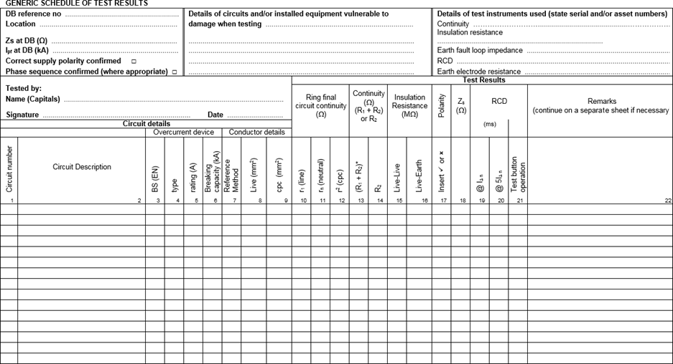
Test results

Slide 6
Any questions?

